Slide 1


Data Science Bootcamp
#1 rated Coding and Data Science Program in all of Orange County, Los Angeles, and the Inland Empire.
Prep Course Introduction - Statistics

Slide 2



Statistics
Statistics is the discipline that is concerned with the collection, organization, analysis, interpretation, and presentation of data.
Source: https://en.wikipedia.org/wiki/Statistics
Statistics is a science of collecting and analyzing data taken from a sample population
Notes:
The goal is to turn data into knowledge

Slide 3
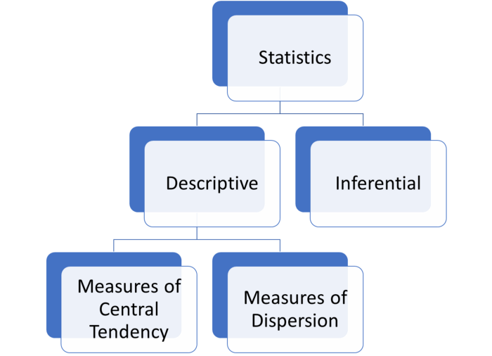
Statistics
Notes:
the first message for statistical thinking is, statistics derives knowledge from sample regarding the population by carefully conducted collection and data
Example of US election survey and its results
the first message for statistical thinking is, statistics derives knowledge from sample regarding the population by carefully conducted collection and data

Slide 4
Population vs Sample
Population
Population is the broader group of people to whom you intend to generalize the results
Sample
Sample is the specific group that you collect data from. To be a truly random sample, every subject in your target population must have an equal chance of being selected in your sample.
Notes:
the first message for statistical thinking is, statistics derives knowledge from sample regarding the population by carefully conducted collection and data
Example of US election survey and its results
the first message for statistical thinking is, statistics derives knowledge from sample regarding the population by carefully conducted collection and data

Slide 5
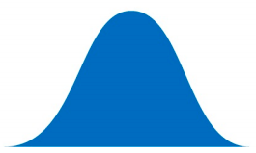
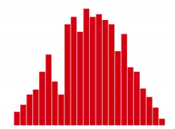
Population vs Sample
Population
Population
Sample
Sample
Notes:
the first message for statistical thinking is, statistics derives knowledge from sample regarding the population by carefully conducted collection and data
Example of US election survey and its results

Slide 6
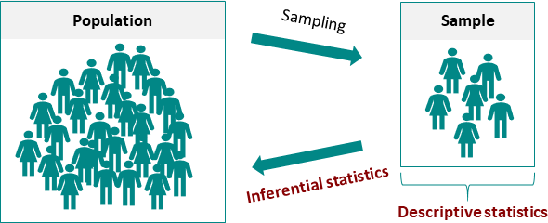
Statistics
Notes:
the first message for statistical thinking is, statistics derives knowledge from sample regarding the population by carefully conducted collection and data
Example of US election survey and its results
the first message for statistical thinking is, statistics derives knowledge from sample regarding the population by carefully conducted collection and data

Slide 7
Population vs Sample
N = Total population
n = Total sample from population

Slide 8
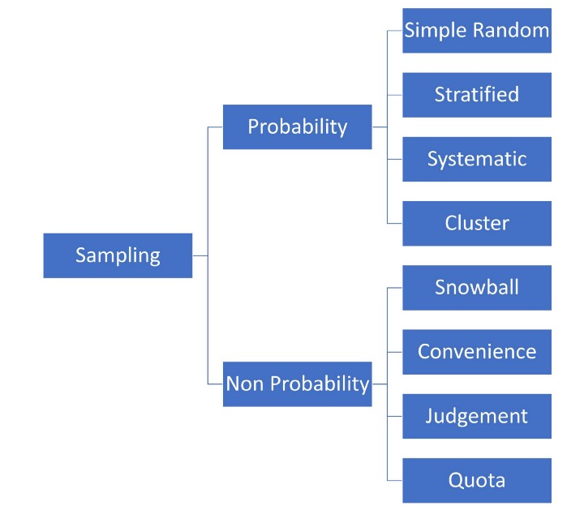
Statistics
Notes:
the first message for statistical thinking is, statistics derives knowledge from sample regarding the population by carefully conducted collection and data
Example of US election survey and its results
the first message for statistical thinking is, statistics derives knowledge from sample regarding the population by carefully conducted collection and data

Slide 9
Population vs Sample
Sample A subset from a larger data set.
Population The larger data set or idea of a data set.
N (n) The size of the population (sample).
Random sampling Drawing elements into a sample at random.
Simple random sample The sample that results from random sampling without stratifying the population.
Sampling with replacement and without replacement

Slide 10
Statisticians and Data Scientists
A sample to a statistician means a collection of data points.
Data scientists will use the term sample for a single data point.

Slide 11
Statisticians and Data Scientists
Statistician, predictor variables are used in a model to predict a response or dependent variable.
For a data scientist, features are used to predict a target.

Slide 12
Data
Data Generation
Data Collection
Knowledge
Business Intelligence
Solutions
Notes:
We have little control on data generation
From generated data we gather data to analysis
We want to drive knowledge, business intelligence and solution based on our data

Slide 13
Data
5
Data is usually a number, for a unit of observation and has a context
Notes:
Data is usually a number, for a unit of observation and has a context
Does 5 mean Age of 5 - years
Height of the person 5 feet
Weight of the person 5 pounds
Does it mean 5ml of rain

Slide 14
Type of data
Types of variable
Quantitative variables
Qualitative variables
Date and time

Slide 15
Quantitative Variable
Types of Quantitative variable
Continuous variables
Discrete variables
Notes:
Discrete data is similar, but is still numeric. An example of discrete data is the sum of two dice thrown. There are a finite and known set of outcomes, but these outcomes are represented numerically. Continuous data concerns data that can take on infinite values between any two points. A good example that really proves this point is that there are infinite values between 1 and 1.01. Continuous data is generally numeric, like in our example above, but can sometimes be represented in date-time format.

Slide 16
Qualitative Variable
Types of Qualitative variable
Ordinal variables
Nominal variables
Notes:
Categorical data is non-numeric and often can be characterized into categories or groups. A simple example is is color; red, blue, and yellow are all distinct colors. Another example could be age groups or other interval-type data. Like 1–25 years old, 25–50 years old, and so on. The data used represents numbers, but the intervals themselves are categorical.

Slide 17
Fundamental Ideas
Estimates of Location
Variance
Uncertainty
Probability

Slide 18
Centrality Measures/ Descriptive statistics
Central tendency measures, which capture the center around which the data is distributed.
Variation or variability measures, which describe the data spread, i.e. how far the measurements lie from the center.

Slide 19
Estimates of Location
Mean: The sum of all values divided by the number of values. Synonyms average
Median: The value such that one-half of the data lies above and below. Synonyms 50th percentile
Mode: The most frequent value
Outlier: A data value that is very different from most of the data. Synonyms extreme value

Slide 20
Central tendency measures
Mean
Arithmetic mean
Weighted mean
Geometric mean
Median
Mode
Notes:
geometric mean is a mean or average, which indicates the central tendency or typical value of a set of numbers by using the product of their values (as opposed to the arithmetic mean which uses their sum).

Slide 21
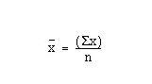
Mean
Average
μ = Mean of population
x = Mean of sample

Slide 22
Mean
Let’s write a function to calculate the mean of a given dataset
1, 2, 4, 5, 5, 7, 8, 9

Slide 23
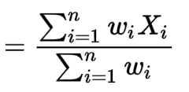
Weighted Mean
μ = Mean of population
x = Mean of sample

Slide 24
Weighted Mean
Let’s write a function to calculator mean of a given dataset
Weighted Values Student 1 Students 2
HW | 15%
Quiz | 15%
Mid term | 35%
Final | 35%
HW | 78
Quiz | 70
Mid term | 89
Final | 94
HW | 100
Quiz | 97
Mid term | 76
Final | 79

Slide 25
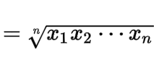
Geometric Mean
μ = Mean of population
x = Mean of sample

Slide 26
Geometric Mean
Let’s write a function to calculator geometric mean of a given data
1, 2, 4, 5, 5, 7, 8, 9

Slide 27
Median
Write a function to find the centre point (50% percentile) of the data
1, 2, 4, 5, 5, 8, 9
1, 2, 4, 5, 5, 7, 8,9

Slide 28
Mode
Write a function to find the most frequent number in the data
1, 2, 4, 5, 5, 8, 8, 9

Slide 29
Estimates of Location
Mean: The sum of all values divided by the number of values. Synonyms average
Weighted mean: The sum of all values times a weight divided by the sum of the weights. Synonyms weighted average
Geometric mean is calculated by multiplying all numbers and then taking the nth root of that number (where n=number of numbers).
Trimmed mean: The average of all values after dropping a fixed number of extreme values. Synonyms truncated mean

Slide 30
Bootstrap and resampling
Bootstrap sample: A sample taken with replacement from an observed data set.
Resampling: The process of taking repeated samples from observed data; includes both bootstrap and permutation (shuffling) procedures.
Notes:
Multiple samples are combined and the sampling may be done without bootstrap

Slide 31
Data
Assumptions about data sampling
Randomization
Measurements of the data
Independence between variables

Slide 32
Variability measures
Variance
Standard Deviation
Coefficient Variation
Notes:
geometric mean is a mean or average, which indicates the central tendency or typical value of a set of numbers by using the product of their values (as opposed to the arithmetic mean which uses their sum).

Slide 33
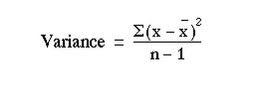
Variance
Spread of data around the mean
𝛔² = Variance of population
S² = Variance of sample
Notes:
Why divide by n-1 : https://www.willemsleegers.com/post/2020/08/05/why-divide-by-n-1/
Bias and unbias : https://www.merriam-webster.com/dictionary/unbiased

Slide 34
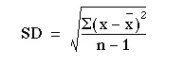
Standard deviation
Square root of variance
𝛔 = Standard deviation of population
s = Standard deviation of sample

Slide 35
Variance
Numbers1 = 3, 4, 4.5, 3.5
Numbers2 = 4.828, 6.437, 7.242, 5.632

Slide 36
Coefficient of variation
Compare two datasets which operate on different scales i.e miles and kilometers
Coefficient of variation = Standard deviation / Mean
Miles = 3, 4, 4.5, 3.5
Kms = 4.828, 6.437, 7.242, 5.632

Slide 37
Covariance

Slide 38
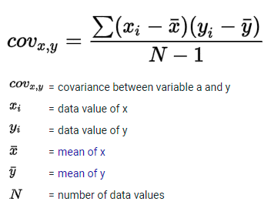
Covariance
Covariance if two values are moving in the same direction
Age | Internet use
18 | 125
25 | 120
40 | 100
50 | 70

Slide 39
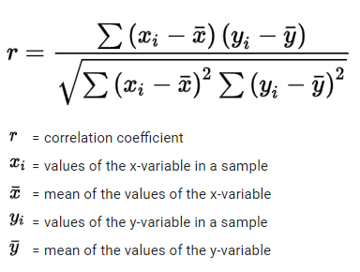
Association between quantitative variables
Statistic used to measure association between quantitative variables is called correlation. It is a single number of statistics for linear association. Correlation is a measure of linear association.
Notes:
Odd’s ratio = p1/(1-p1) / p2/(1-p2)
= 2.846 / 0.219
= 12.995

Slide 40
Correlation coefficient
r = Covariance(x,y) / S(x) * S(y)
1 is perfect positive correlation
-1 is perfect negative correlation
0 means no correletion

Slide 41
Hypothesis Testing
Hypothesis testing is a statistical inference technique used to confirm or refute statements made about a population using the sample data provided. We can think of hypothesis testing as an experiment, an hypothesis is made before the experiment starts. After experimentation, we would confirm if the results agree with the statement or not.

Slide 42
Hypothesis Testing
Hypothesis testing is one of the most significant aspects of inferential statistics. There are several tests applied in hypothesis testing and the specific test to use depends on the data and purpose of the test.
Z Test & T-Test
Correlation Test
Chi Square Tests

Slide 43
Z Test & T-Test
Z-Test is a hypothesis test typically used to determine if the means of two populations are significantly different or if the mean of a population is greater than, less than or equivalent to a specific value. This test is used when the variance(s) of the population(s) is/are known. It is also applied when the data follows a normal distribution. When the sample size is large, it is also assumed that the data follows a normal distribution.

Slide 44
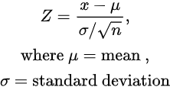
Z Test & T-Test

Slide 45
Z Test & T-Test
Using a case study of the performance of students in 2 classes, the Z Test can be used to ascertain if there is a significant difference in score. In this scenario, the null hypothesis is that the mean scores from the two classes are equal. The hypothesis test would enable us to support or refute this claim. Usually, for hypothesis tests, a 5% level of significance is applied and the claim is rejected if the p-value produced is less than the level of significance.

Slide 46
Z Test & T-Test
from statsmodels.stats.weightstats import ztest
 | classA = [70, 80, 65, 42, 39, 92, 81, 54, 34, 56, 78, 92, 10, 95, 63, 55, 52, 58, 50, 61, 72, 73, 81, 82, 90, 42, 34, 42, 95, 82, 70, 70]
 | classB = [70, 68, 69, 40, 80, 29, 50, 54, 34, 52, 67, 45, 50, 8, 50, 52, 52, 85, 40, 60, 72, 37, 17, 28, 70, 56, 34, 24, 80, 34, 80, 70]
 | ztest(cityA, cityB, value=0)

Slide 47
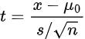
Z Test & T-Test
The T-Test has a similar purpose as the Z-Test. However, it is applied when the population standard deviation is not known, or for samples with small sample sizes (n < 30).

Slide 48
Z Test & T-Test
import scipy.stats as stats
speed = [15, 20, 10, 8, 7, 10, 8, 11, 12, 11]
stats.ttest_1samp(speed, popmean=10)

Slide 49
Correlation
Correlation describes the degree of relationship between two (or more) variables. For example, there might be a positive relationship between hours of practice and overall performance: “The more you practice, the better your results in an examination will be”.
The correlation test tests if the relationship between these variables is statistically significant. The Pearson Correlation Coefficient is a popular correlation coefficient that measures the linear relationship between 2 variables.

Slide 50
Correlation
import scipy.stats as stats
test_scores = [15, 16, 12, 13, 18, 12, 10, 8, 7, 15]
exam_scores = [72, 68, 60, 54, 89, 50, 40, 34, 32, 73 ]
corr = stats.pearsonr(test_scores, exam_scores)
print (corr)

Slide 51
Chi-Square Tests
There are 3 types of Chi-Square Tests:
Chi-Square Test of Independence
Chi-Square Goodness of Fit Test
Chi-Square Test of Homogeneity
The most popularly of these tests are the Chi Square Test of Independence and the Goodness of Fit Test.

Slide 52
Chi-Square Tests
The Chi-Square Goodness of Fit test is used, mostly, to ascertain if the sample data is a true representation of the population. On the other hand, the Chi-Square test of independence is used to determine if the relationship between two categorical variables is significant. It is different from the Correlation test because, unlike the correlation test that focuses on quantitative variables, this chi-square test deals with categorical variables.

Slide 53
Chi-Square Tests
The scipy’s stats.chisquare function is used to compute the goodness of fit test while the chi2_contigency function is used to compute the chi-square test of independence.

Slide 54
Data Structures
Rectangular data (Structured data)
Unstructured data
Time series data
Spatial data
Graph (or network) data
Notes:
Graph refers to connections among entities, and to the underlying data structure. In statistics, graph is used to refer to a variety of plots and visualizations,

Slide 55
DATA SCIENCE ADDITIONAL READINGS
ASA Whitepaper: Discovery with Data: Leveraging Statistics with Computer Science to Transform Science and Society. http://www.amstat.org/policy/pdfs/BigDataStatisticsJune2014.pdf
A Cartoon Guide to Statistics http://www.amazon.com/Cartoon-Guide-Statistics-Larry-Gonick/dp/0062731025
Naked Statistics http://www.amazon.com/Naked-Statistics-Stripping-Dread-Data/dp/1480590185

Slide 56
Variation or variability measures
Variance
Standard deviation
Range
Interquartile Range (IQR)

Slide 57
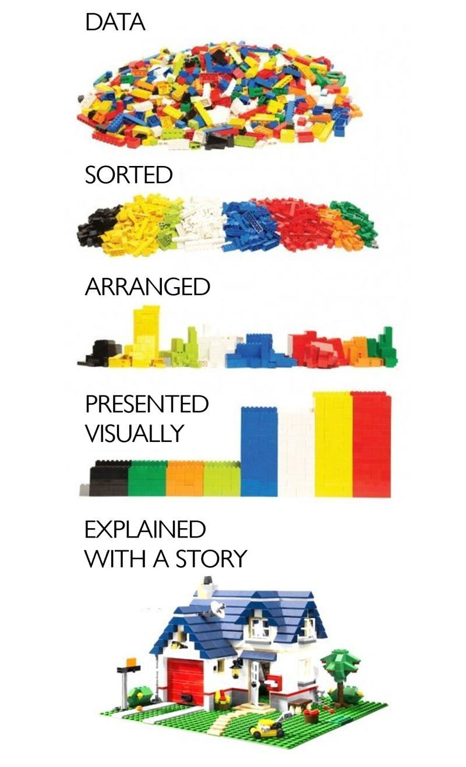
Data

Slide 58
Variability Metrics
Deviations: The difference between the observed values and the estimate of location. Synonyms errors, residuals
Variance: The sum of squared deviations from the mean divided by n – 1 where n is the number of data values. Synonyms mean-squared-error
Standard deviation: The square root of the variance.

Slide 59
Variability Metrics
Mean absolute deviation: The mean of the absolute value of the deviations from the mean.
Median absolute deviation from the median: The median of the absolute value of the deviations from the median.

Slide 60
Variability Metrics
Interquartile range: The difference between the 75th percentile and the 25th percentile. Synonyms IQR

Slide 61
Estimates of Location
Median: The value such that one-half of the data lies above and below. Synonyms 50th percentile
Weighted median: The value such that one-half of the sum of the weights lies above and below the sorted data.

Slide 62
Central limit theorem
Sample statistic A metric calculated for a sample of data drawn from a larger population.
Data distribution The frequency distribution of individual values in a data set.
Sampling distribution The frequency distribution of a sample statistic over many samples or resamples.
Central limit theorem The tendency of the sampling distribution to take on a normal shape as sample size rises.
Standard error The variability (standard deviation) of a sample statistic over many samples (not to be confused with standard deviation, which, by itself, refers to variability of individual data values).

Slide 63
Central limit theorem
Means drawn from multiple samples will resemble the familiar bell-shaped normal curve (see “Normal Distribution”), even if the source population is not normally distributed, provided that the sample size is large enough.
Standard error can be estimated using a statistic based on the standard deviation s of the sample values, and the sample size n.
SE = s/(n)^1/2

Slide 64
Key terms
Error The difference between a data point and a predicted or average value.
Standardize Subtract the mean and divide by the standard deviation.
z-score The result of standardizing an individual data point.
Standard normal A normal distribution with mean = 0 and standard deviation = 1
Tail The long narrow portion of a frequency distribution, where relatively extreme values occur at low frequency.
Skew Where one tail of a distribution is longer than the other.

Slide 65
Central tendency measures
Mean
Arithmetic mean
Geometric mean
Median
Mode

Slide 66
Variation or variability measures
Variance
Standard deviation
Range
Interquartile Range (IQR)

Slide 67
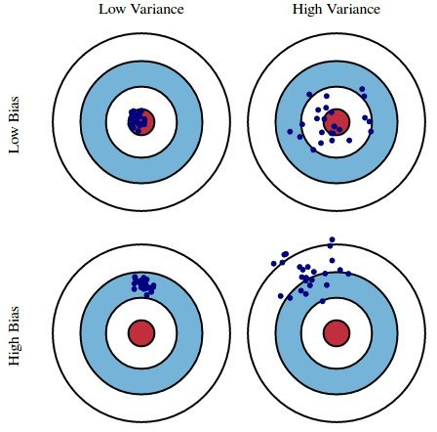
having an expected value equal to a population parameter being estimated
Bias vs Variance

Slide 68
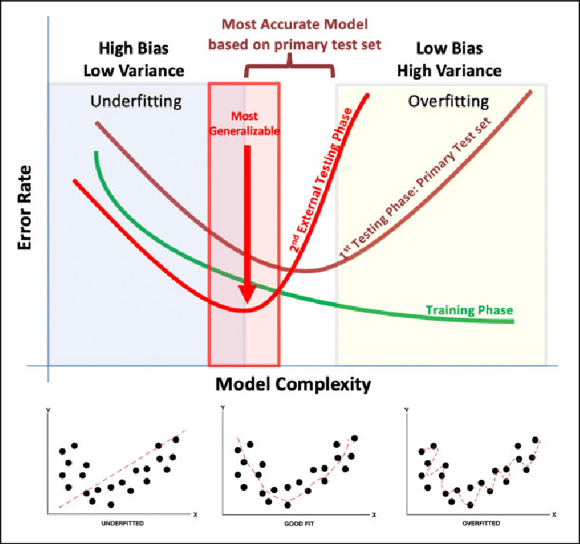
Bias vs Variance

